Slide 1
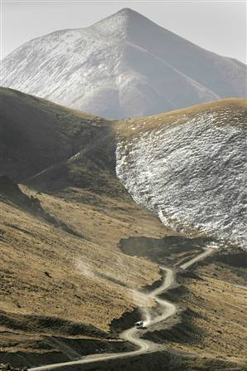
WELCOME
NEH SUMMER INSTITUTE
LITERATURES, RELIGIONS and ARTS
of the HIMALAYAN REGION

Slide 2
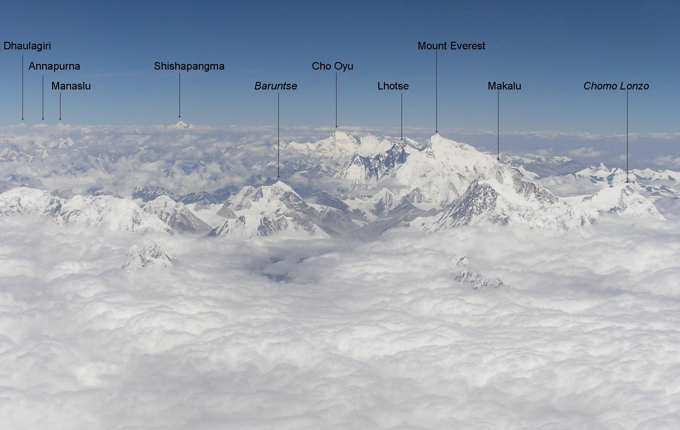
The Great Himalayan Range in Central Nepal
“Himalaya” = “Abode of Snow”

Slide 3
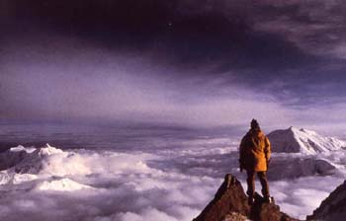

Slide 4
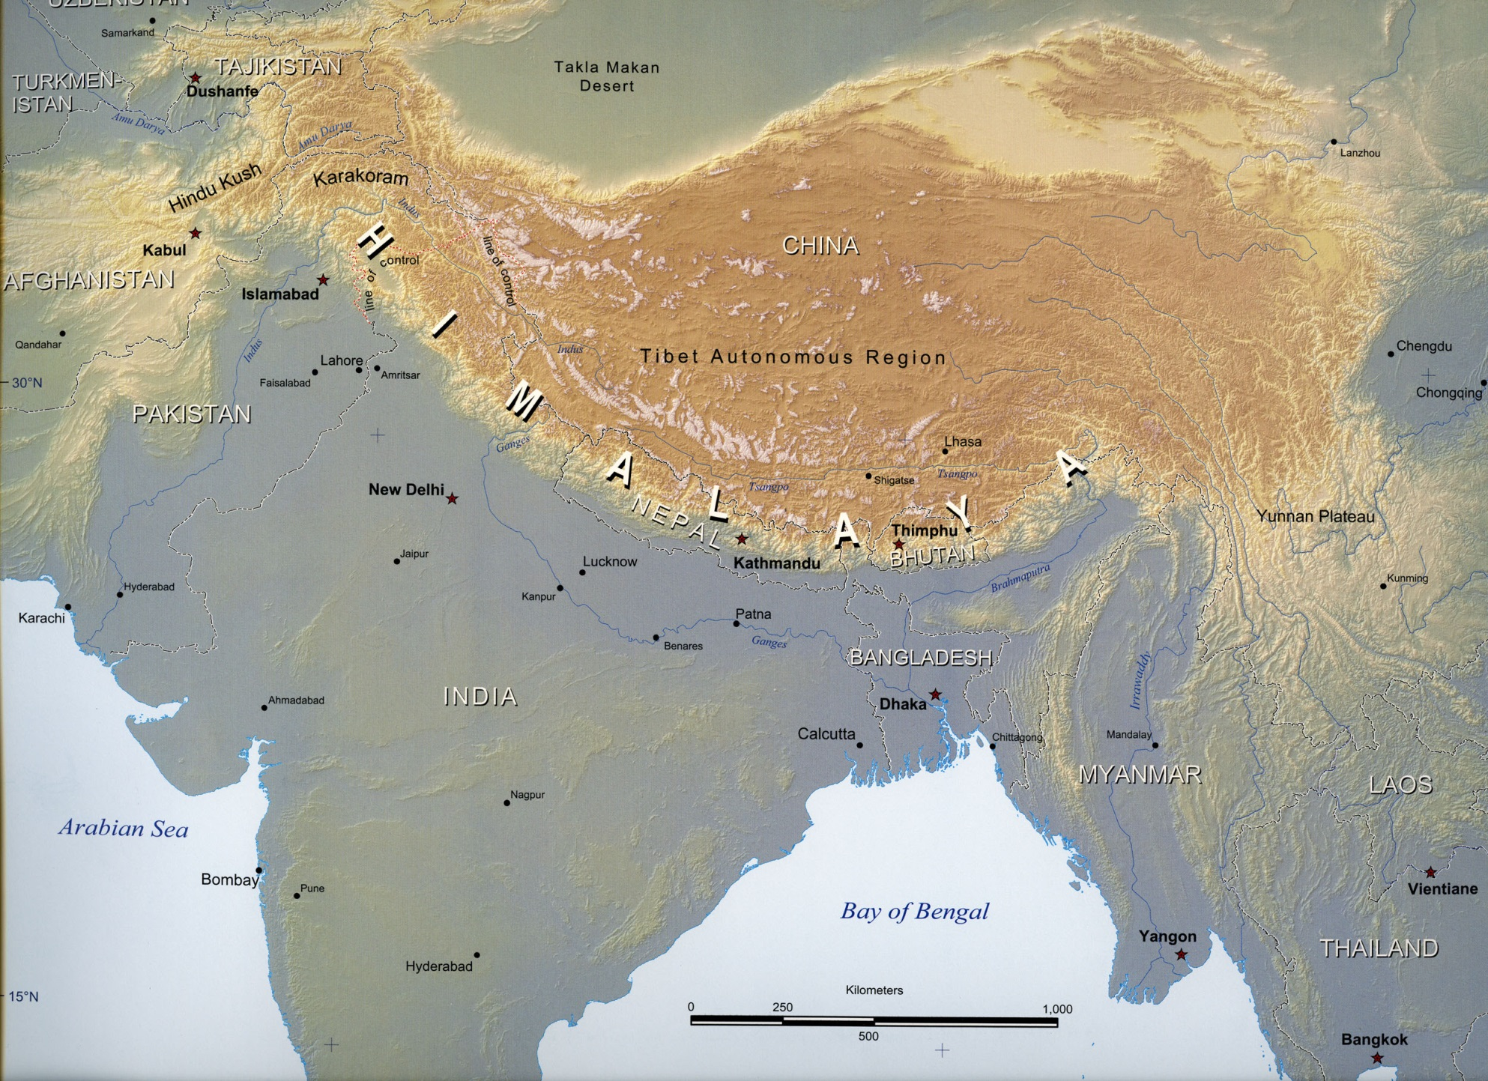
THE HIMALAYAS

Slide 5
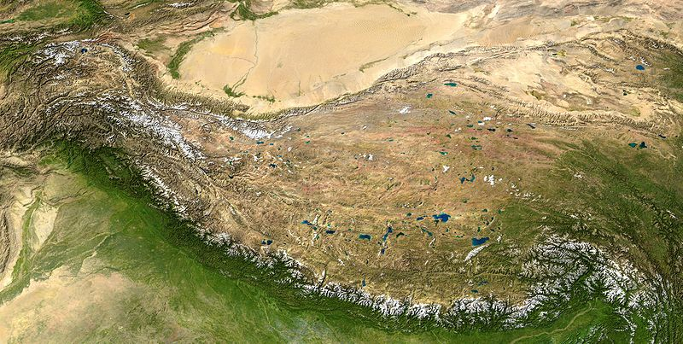
TIBETAN PLATEAU

Slide 6
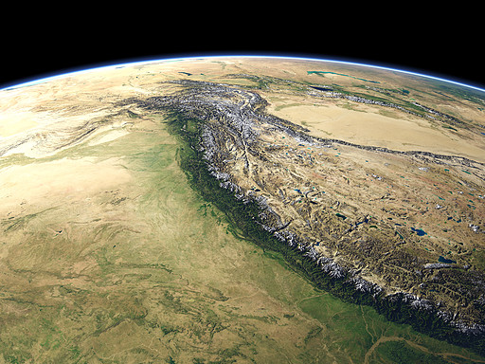

Slide 7
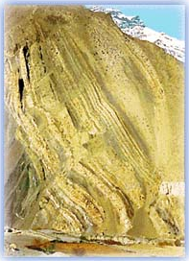
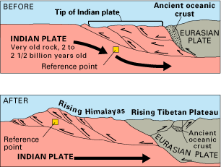
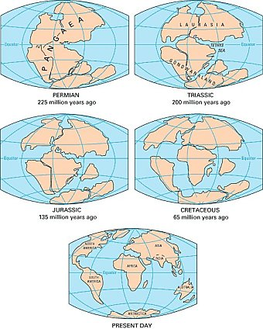
Geology
The Himalayas were thrust up when India collided with Asia 50 million years ago

Slide 8
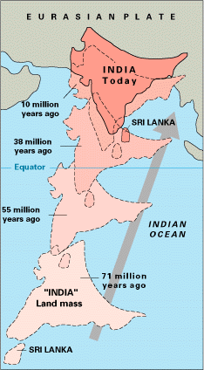
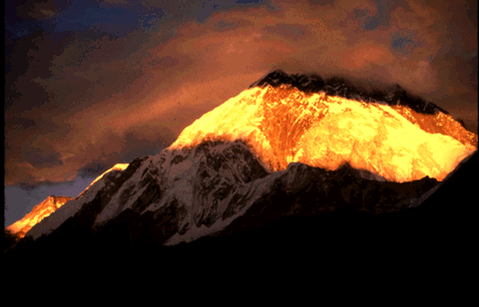
PLATE TECTONICS
SAME KIND OF ROCK, BOTH PLATES, PUSHED UPWARDS

Slide 9
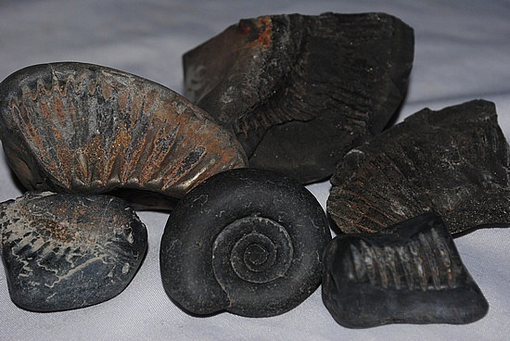
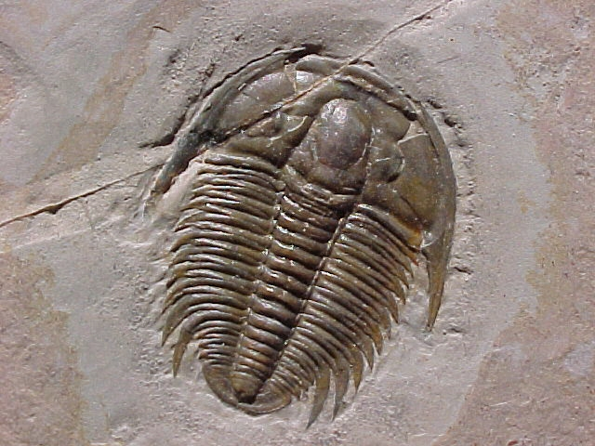
MUCH OF THE LAND THAT WAS PUSHED UP WAS ONCE UNDERWATER.
FOSSILS OF ANCIENT UNDERWATER CREATURES NOW FOUND AT HIGH ELEVATION IN THE MOUNTAINS.
Notes:
RIGHT – WELL PRESERVED CEPHALOPOD FOSSIL, FOUND AT 19,000’
LEFT – The spiral fossils, called ammonites in scientific parlance, are called Shaligrams are regarded as sacred, emblems of the god Vishnu. They are collected in the Himalayas and distributed in Hindu shrines across India.
These can be purchased for classroom use from fossil supply sources.
9

Slide 10
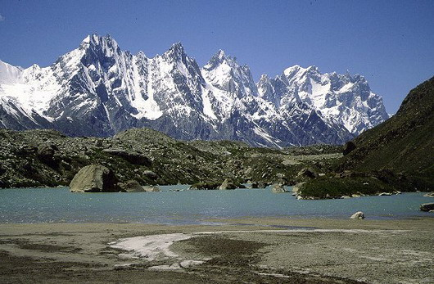
Mountains CONTINUE TO RISE UPWARD at the rate of 1CM/YEAR
HOME TO ALL 14 OF THE EARTH’S PEAKS >8,000 METERS
Notes:
FERTILE SOIL (SILT) HAS WASHED DOWN FROM THE MOUNTAINS INTO THE GANGES VALLEY AND THE INDIAN PLAIN FOR MILLENNIA. (MAP)
SCANNED ELEVATION MAP IMAGES
10

Slide 11
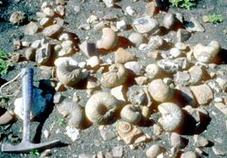
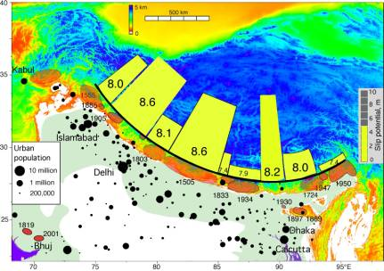
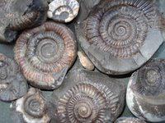
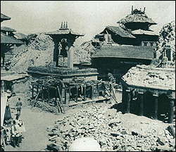
Geology’s Factors on Himalayan Life
Ammonites, fossilized sea creatures found up to 18,000 ft. in the region, are sacred to Hindus as symbols of Vishnu.
SHALIGRAM
Kathmandu 1934

Slide 12
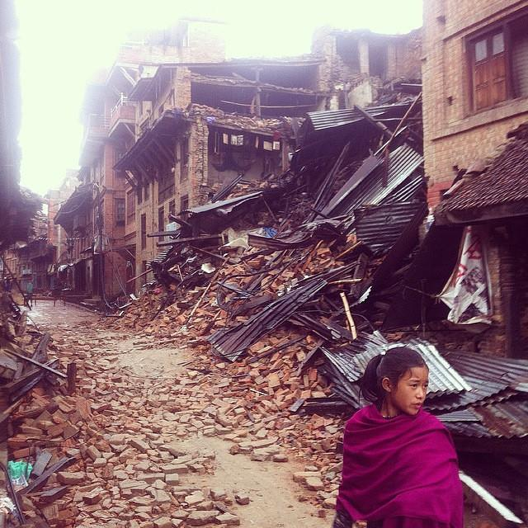
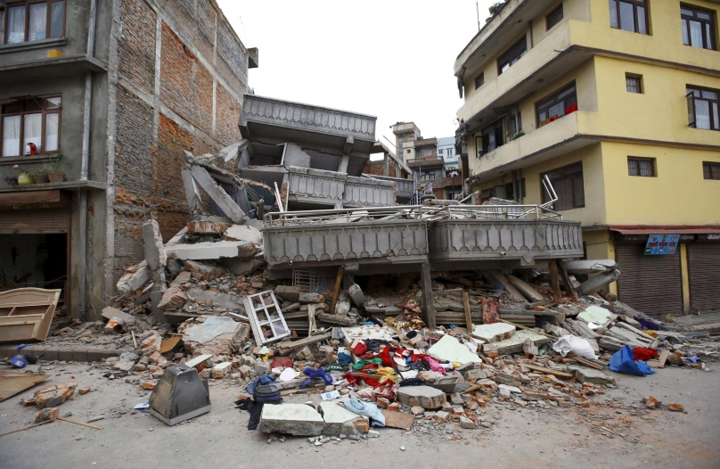
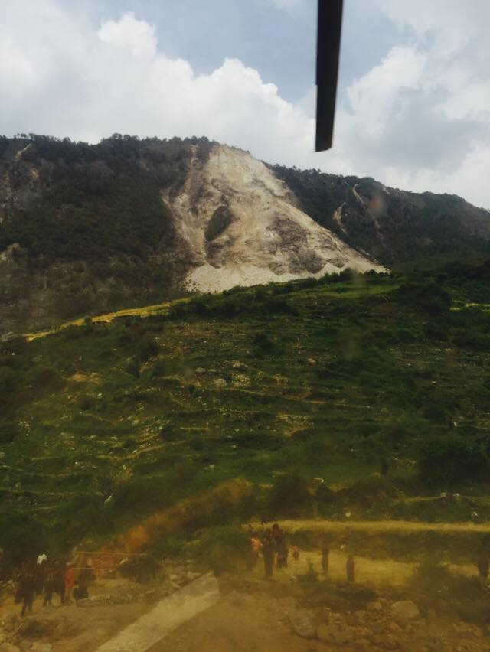
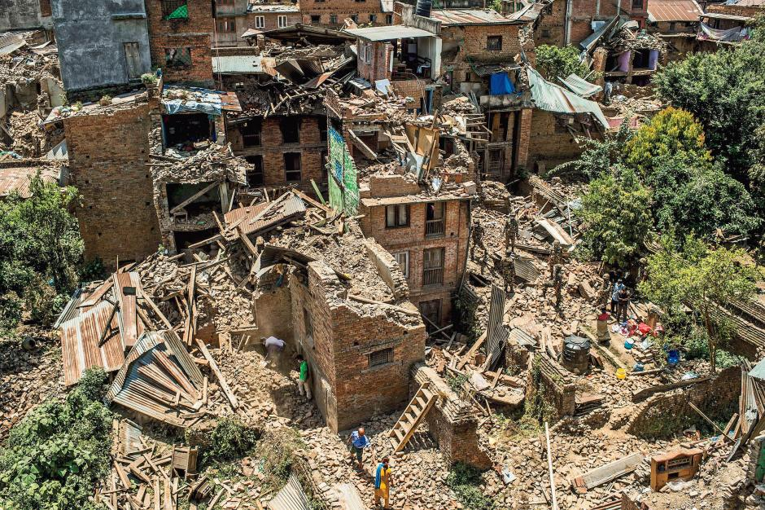
2015

Slide 13
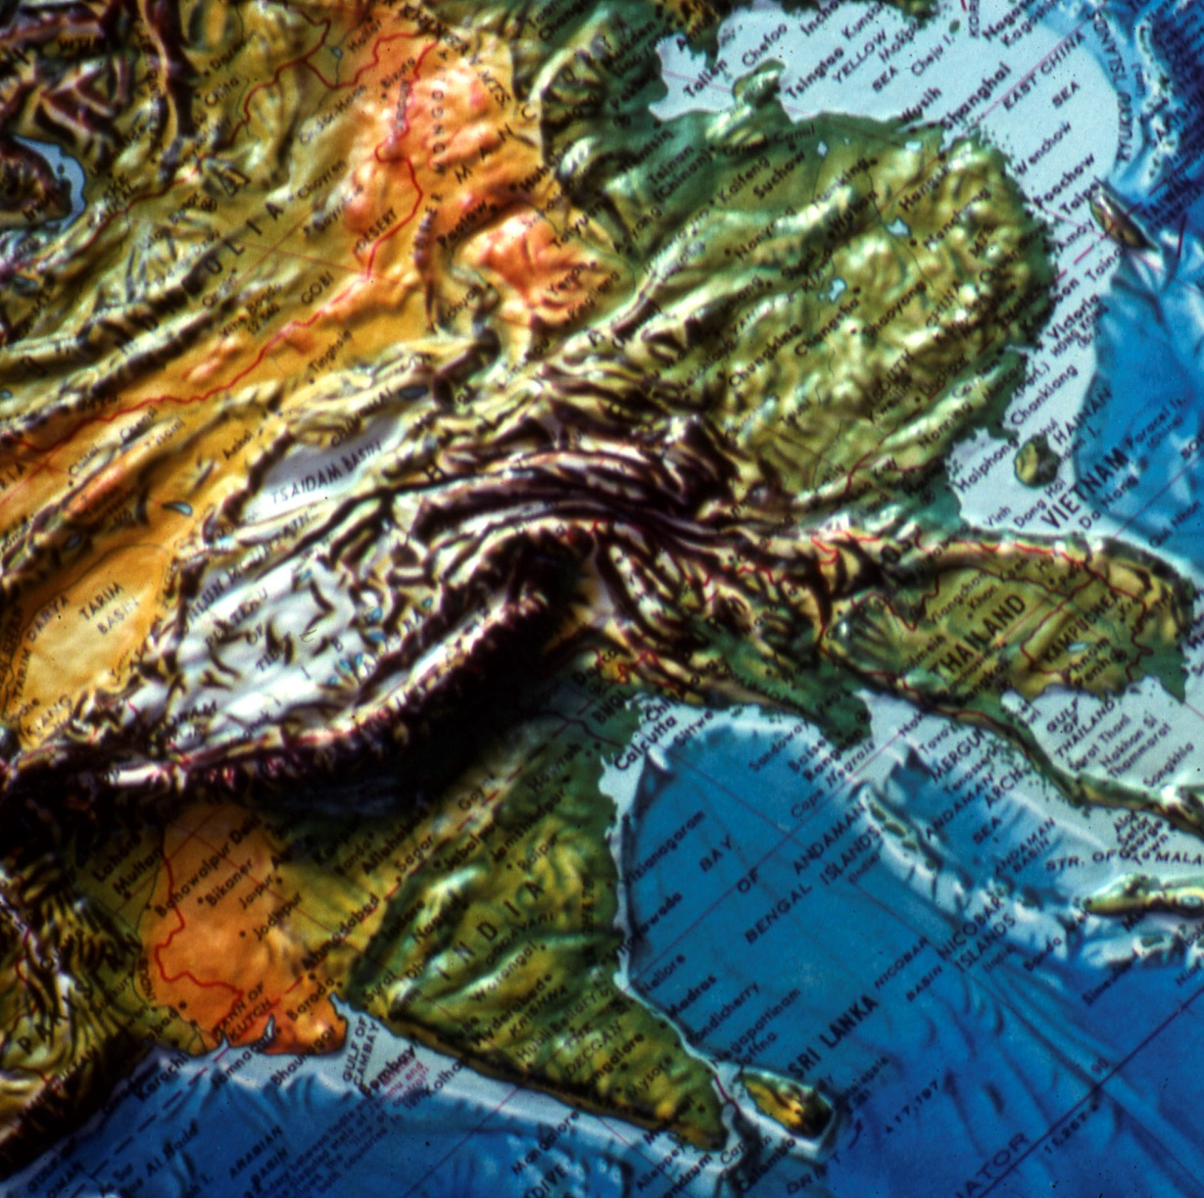
Look again:
Himalayas as Barrier between India and China

Slide 14
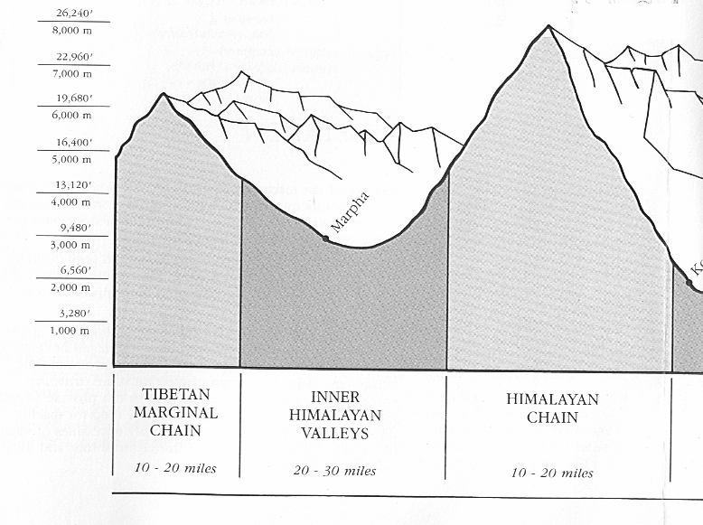
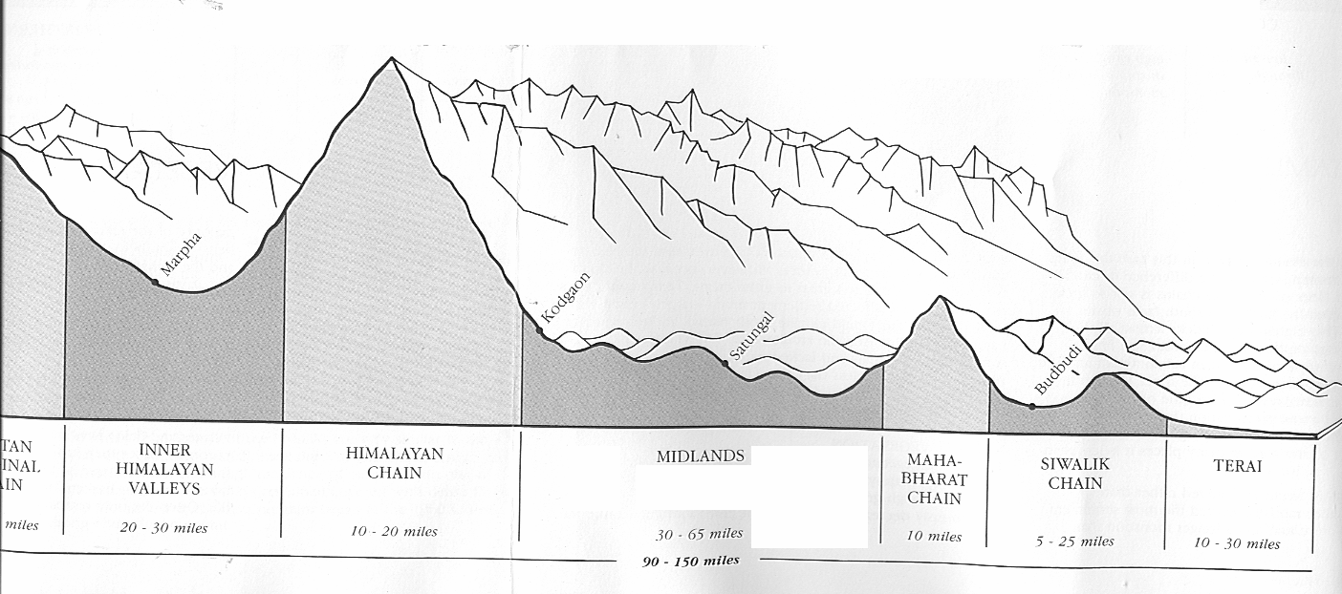
Geological-Geographical Regions in Cross Section
Tibetan Plateau
Peaks to Gangetic Plain: 100-120 miles

Slide 15
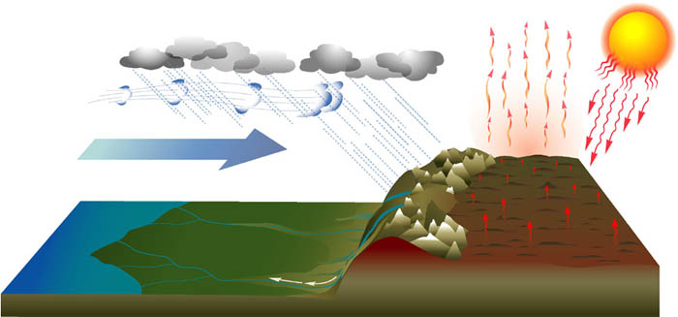
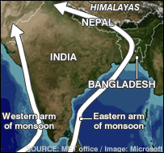
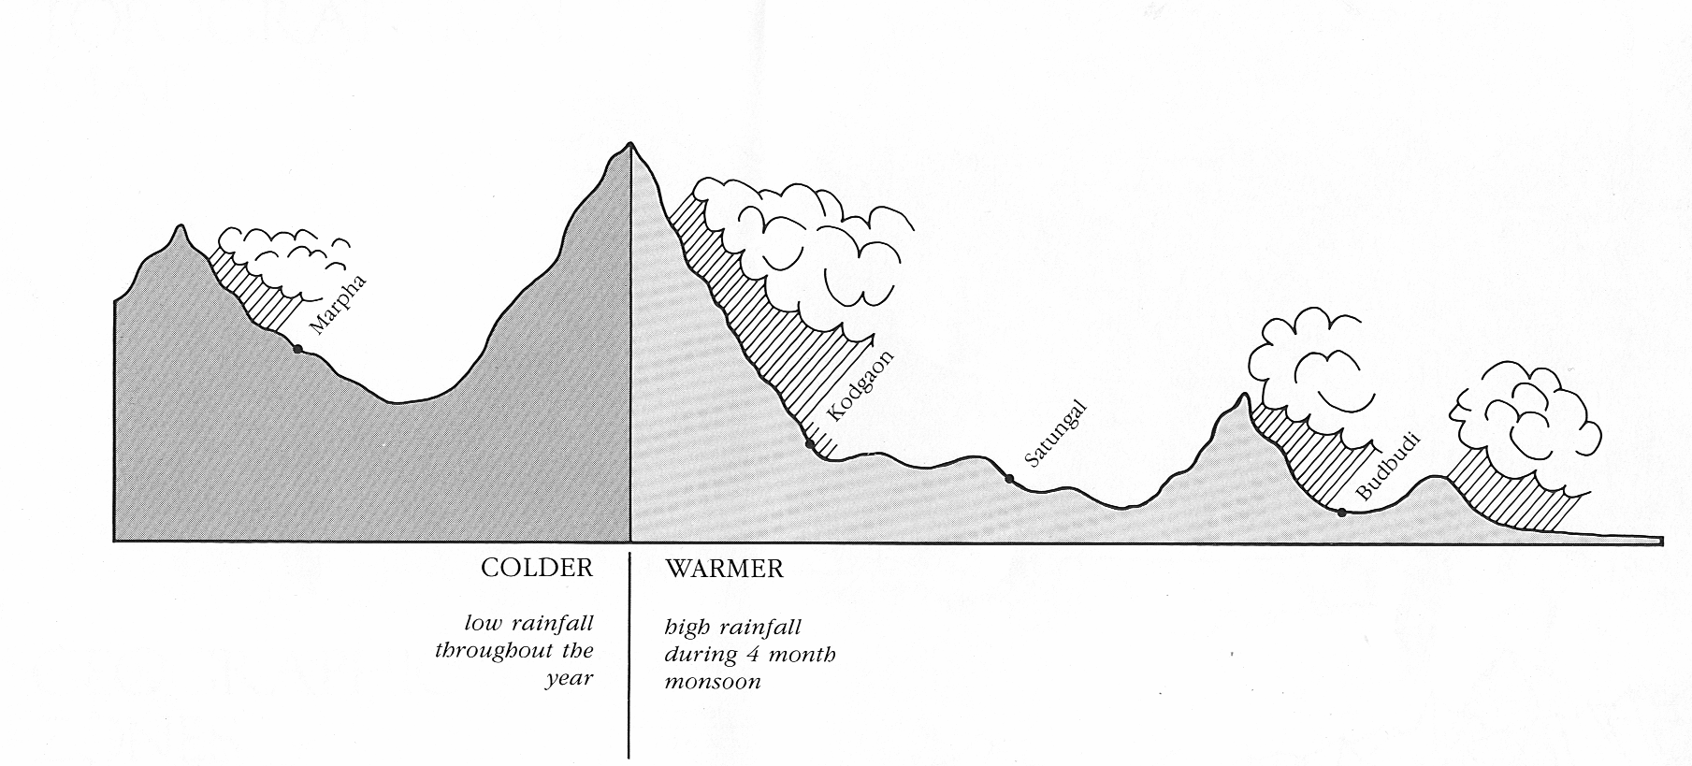
Monsoon Climate:
Atmospheric forces and
Himalayan Micro-ecological regions

Slide 16
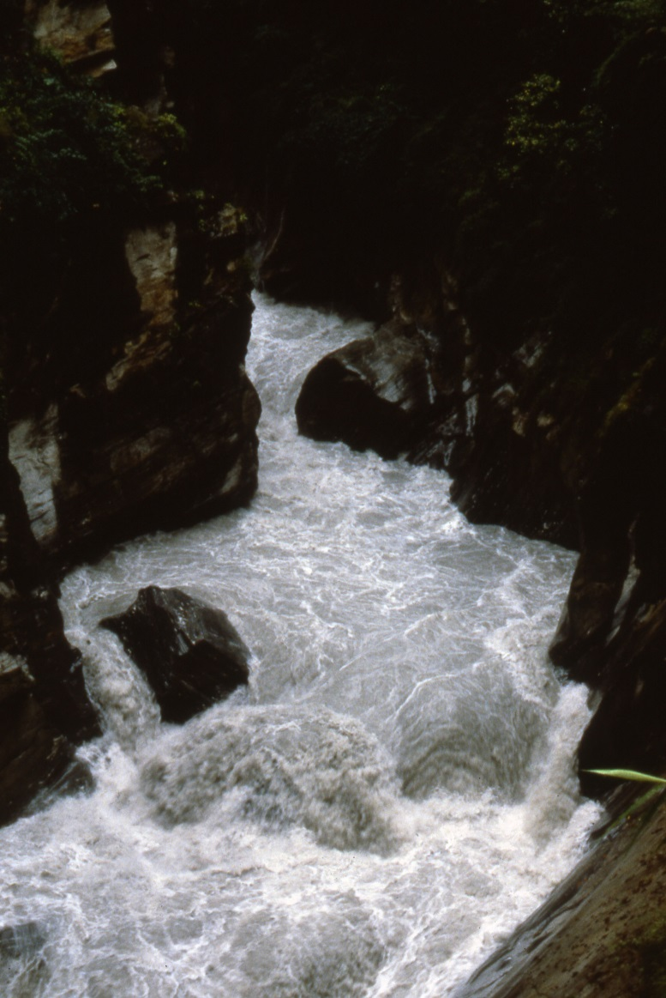
Monsoon and Mountains
Rains cause flooding, as rivers swell to many times the average flow for the four months from June-September
Tons of silt flow into the Indus and Ganges rivers from the mountains, adding to the land’s fertility, even while causing seasonal flooding in the plains.
Rainfall heaviest in the eastern Himalayas
INVALUBALE TO HIMALAYAN and Plains’ FARMERS.
Notes:
A valuable exercise for students is to think about the land in terms of watersheds. In the Himalayas, it is the largest spread of a watershed: from Himalayan glaciers to streamlets, to streams, to rivers that pierece the mountains intop the Gangetic plains.

Slide 17
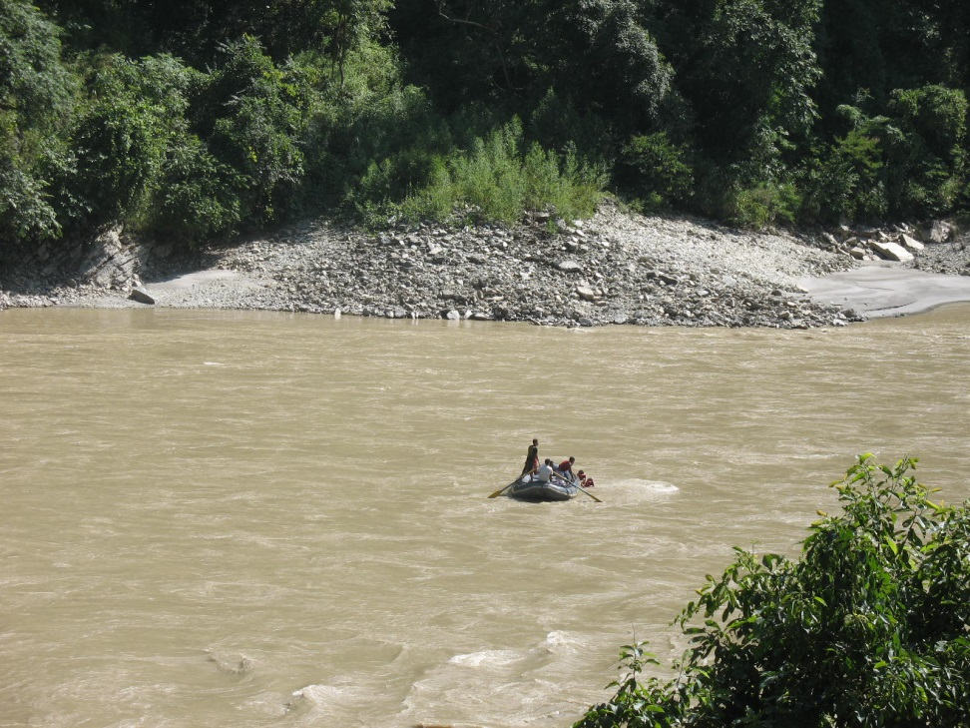
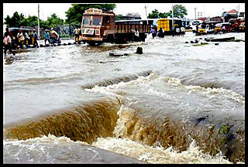
Tons of silt flow into the Indus and Ganges rivers from the mountains, adding to the fertility, even while causing seasonal flooding in the plains.

Slide 18
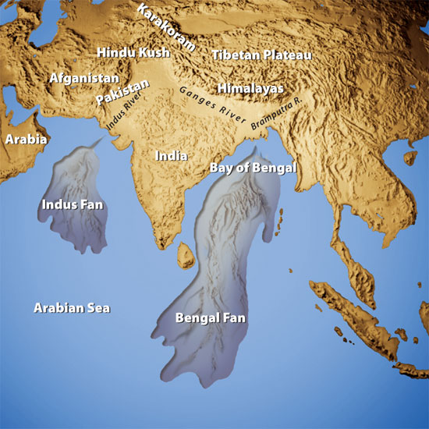

Slide 19
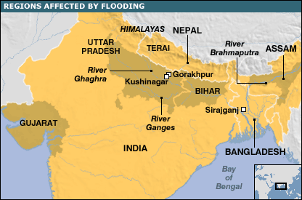
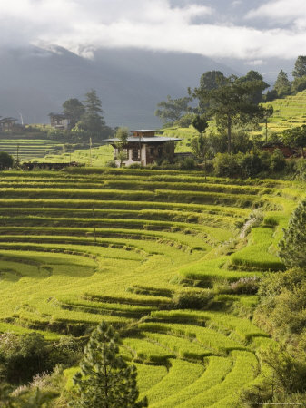
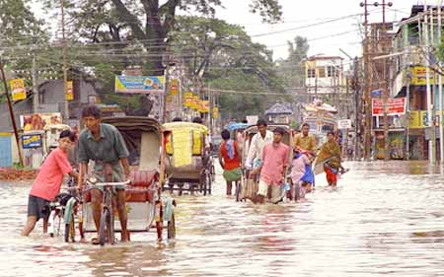
Monsoon as Primary Factor in South Asian Life

Slide 20
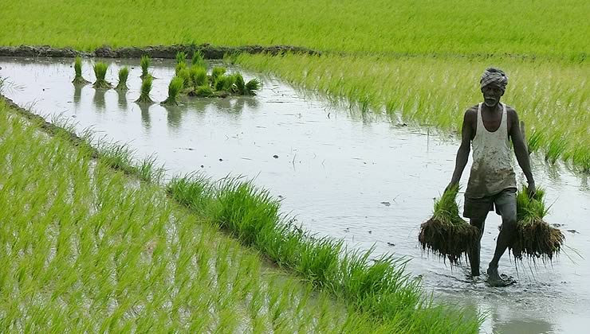
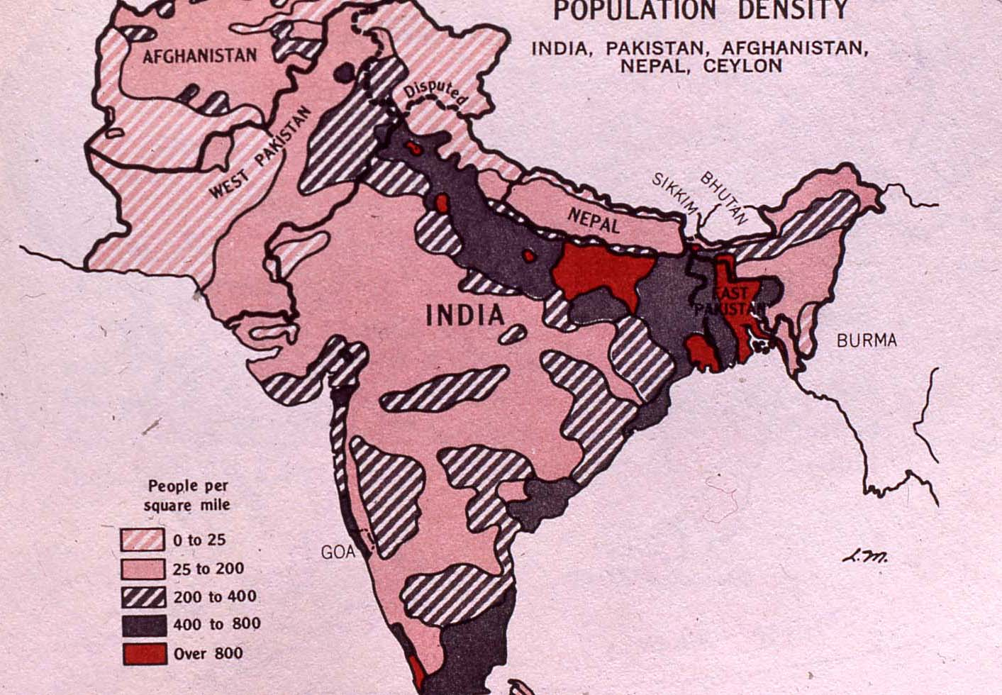
Himalayan Silt, Watersheds ... as Basis for South Asia’s Agricultural Fertility

Slide 21
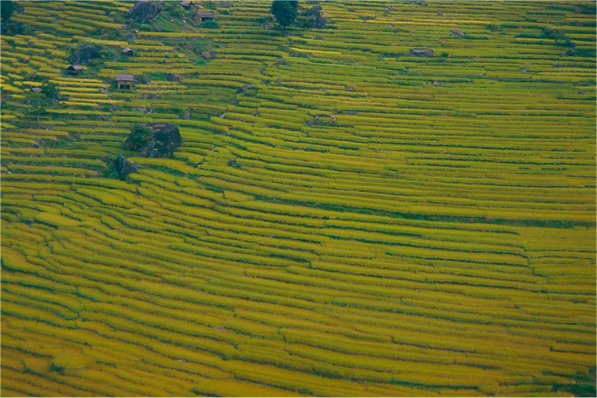

Slide 22
HIMALAYAN CLIMATES
Wide variety of climates, diversity in agriculture & plant life across land
Himalayan biomes: alpine, temperate, subtropical, and tropical.
East to west: precipitation differs astronomically. Eastern Himalayan regions (Bhutan, Tibet, Eastern India) receive the 2nd most rainfall annually in the world.

Slide 23
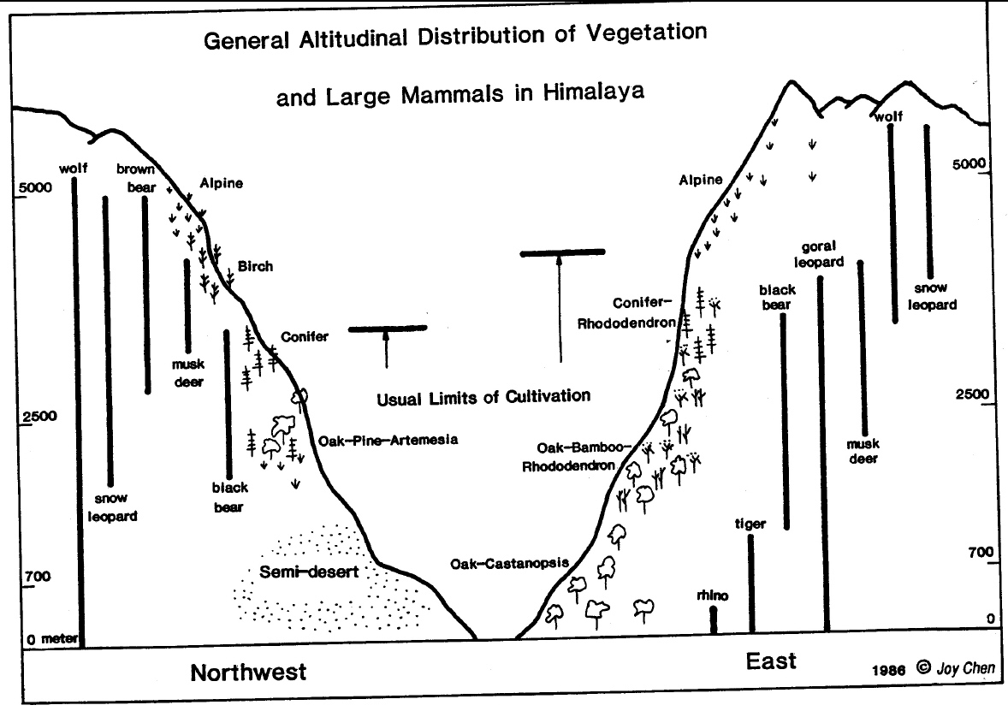

Slide 24
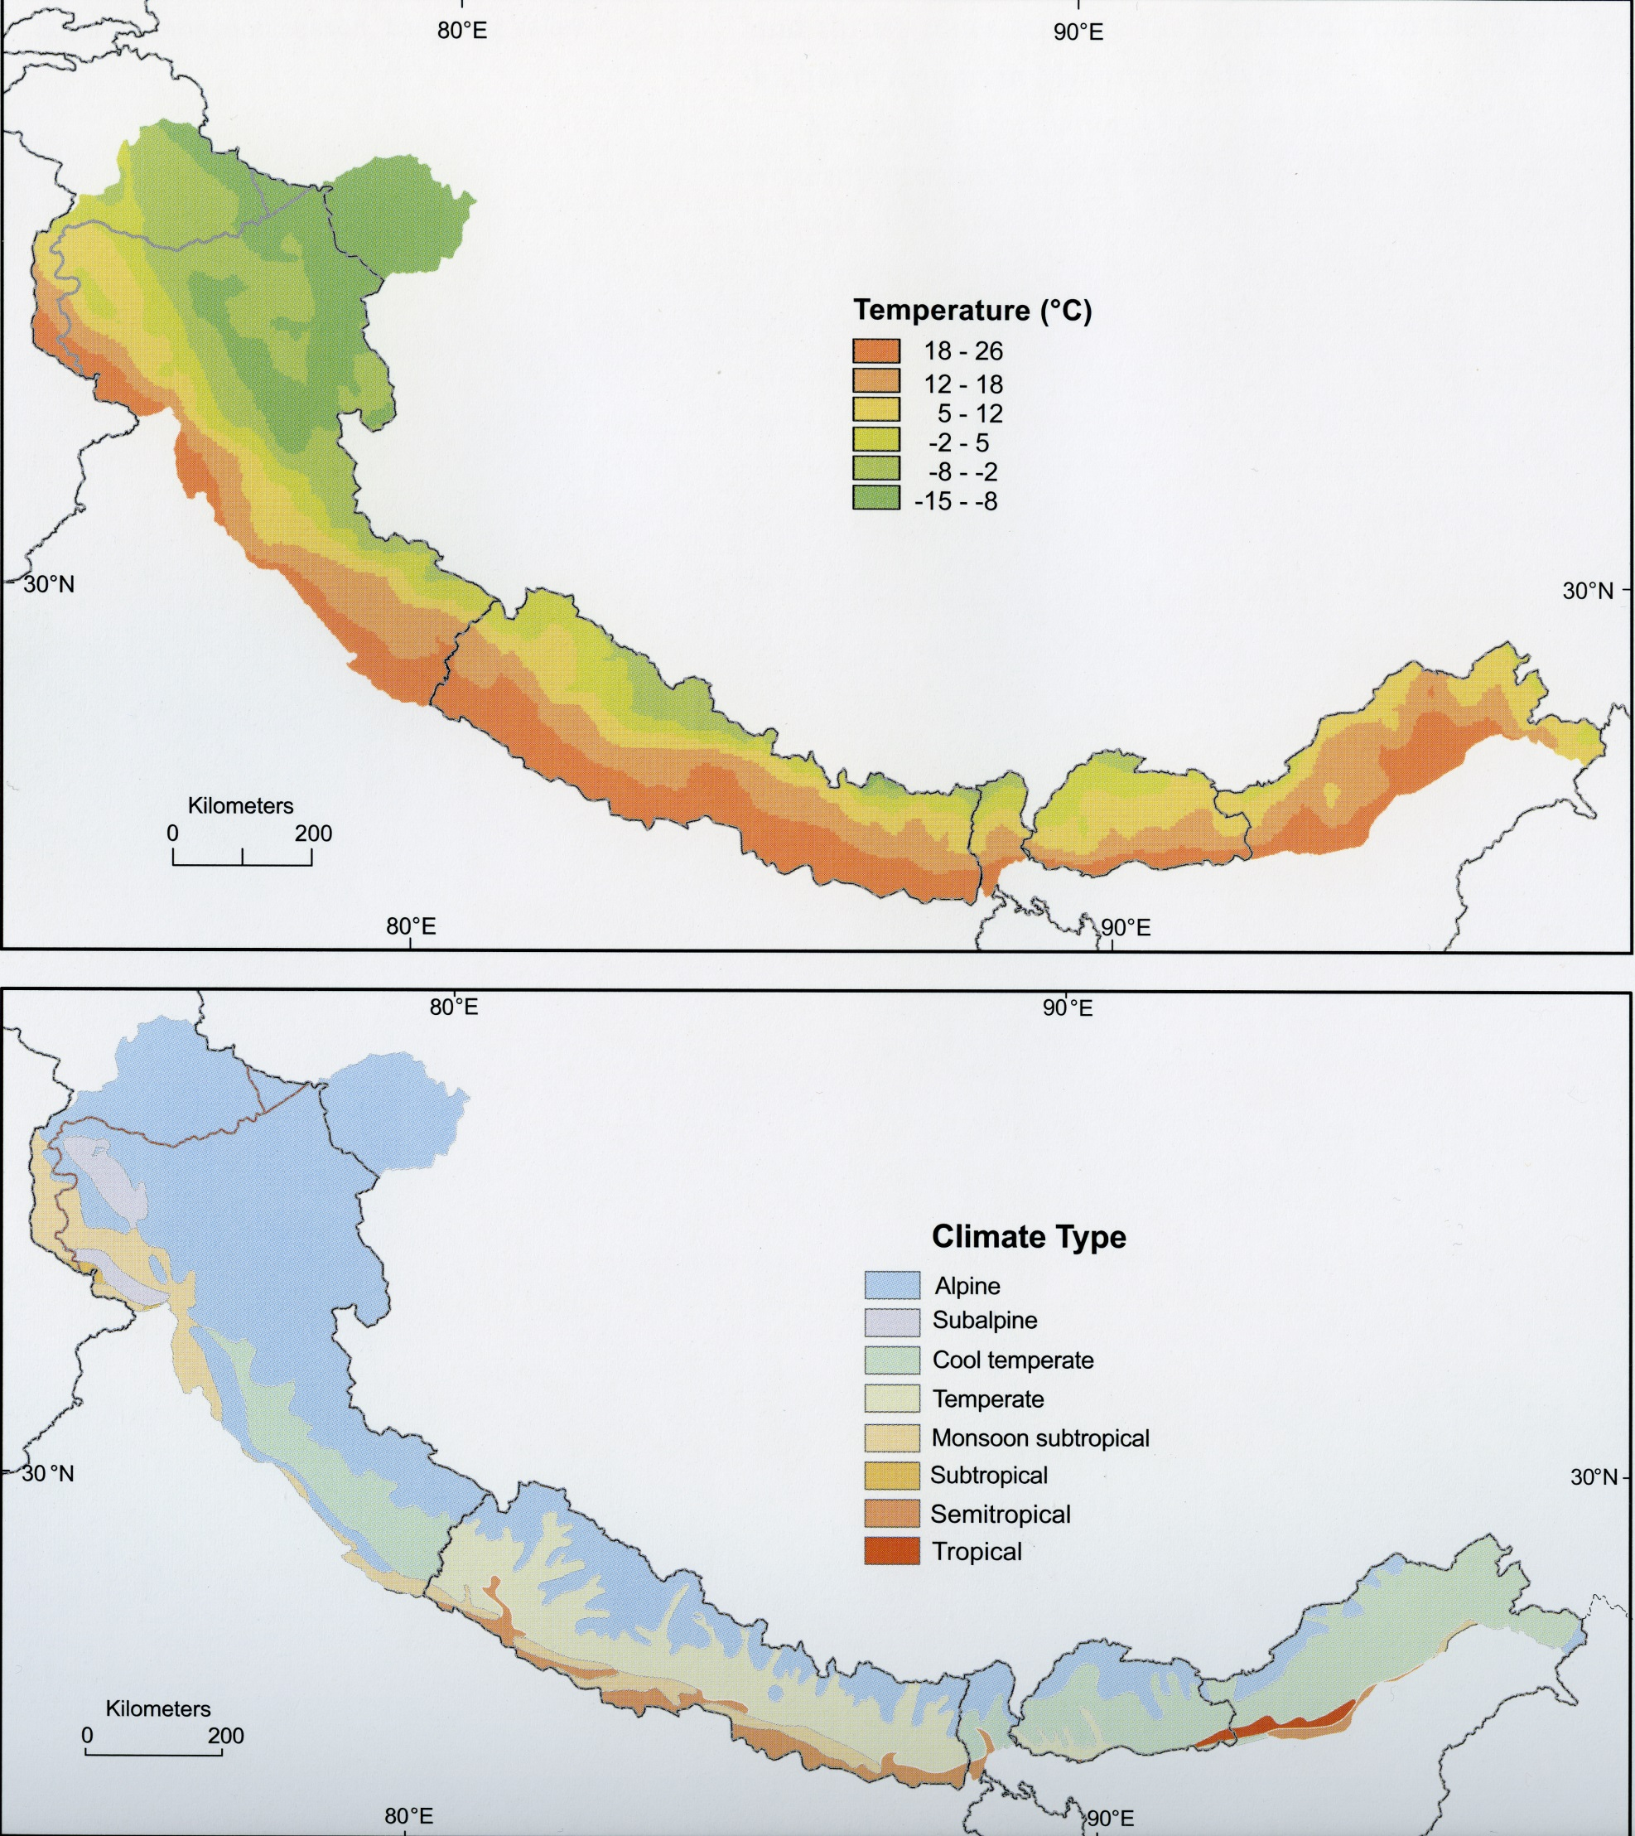
CLIMATE DIVERSITY

Slide 25
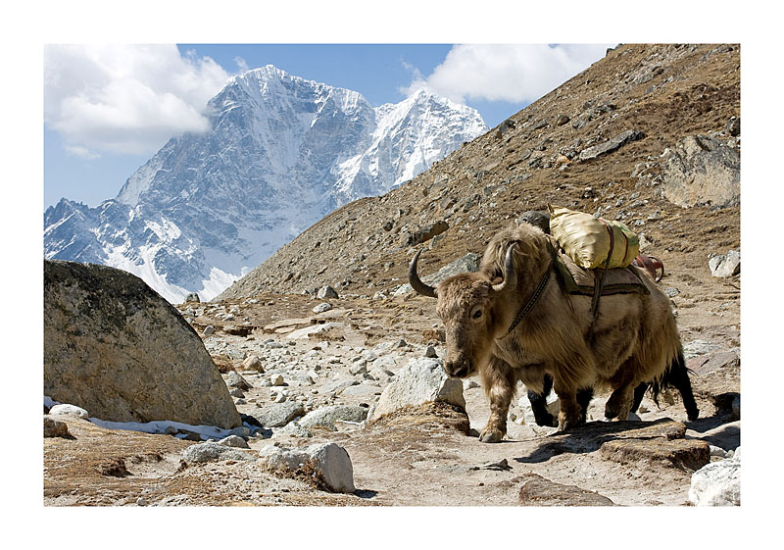
ALPINE ZONE
No vegetation exists above the permafrost line
Alpine vegetation: dwarf trees, mosses, lichen, and other short season wildflowers
TREES: Fir, birch, juniper
cypress, and spruce

Slide 26
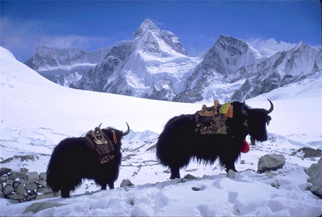
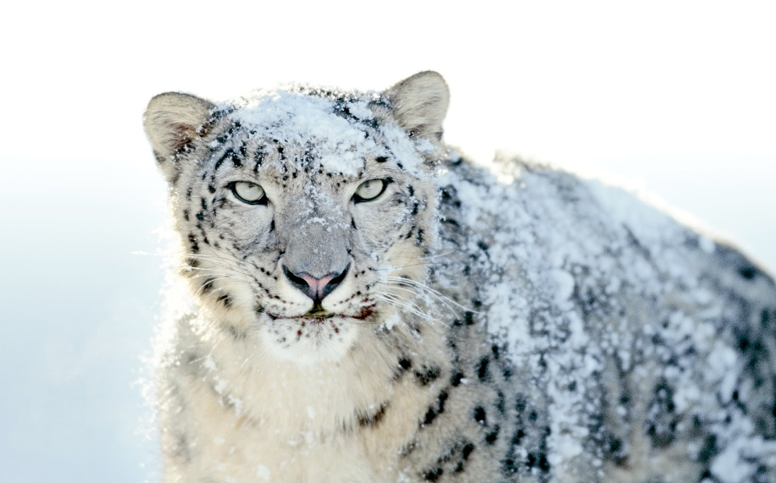
ALPINE ZONE
Home to yaks, wild goats, wolves, and snow leopards.
Sheep, often accompanied by nomadic highland natives. Graze in the sub-alpine region.
ABOVE: SNOW LEOPARD
LEFT: TIBETAN YAK

Slide 27
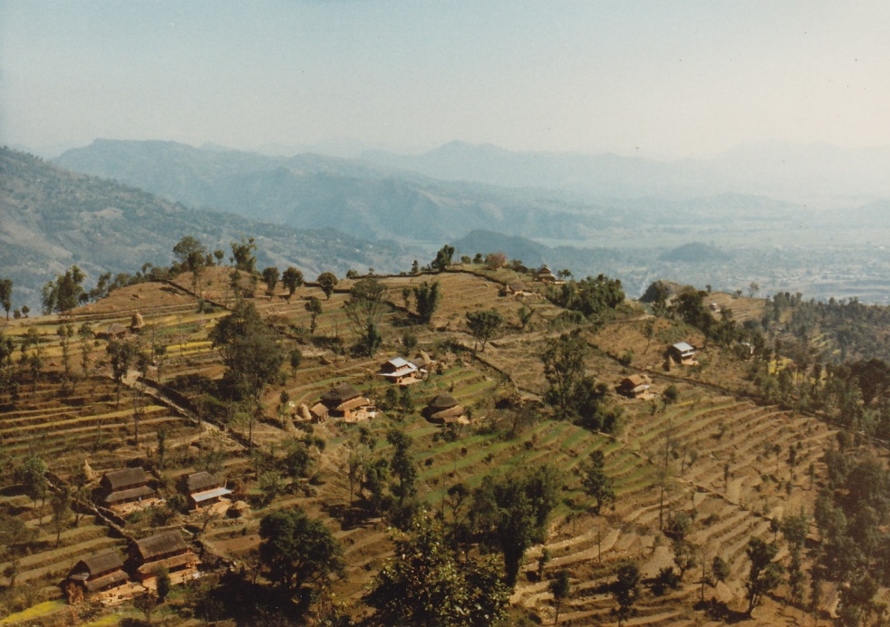
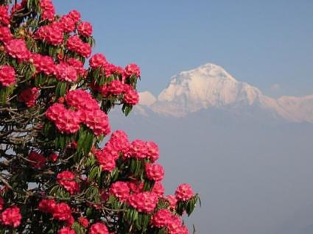
TEMPERATE ZONE
Temperate zone is home to a wider variety of life, both flora & fauna.
Forests of pine, oak, poplar, walnut, larch. (Most areas inaccessible to logging operations)
Domesticated animals: yak-cow crossbreeds thrive, with goats, sheep
Notes:
27

Slide 28
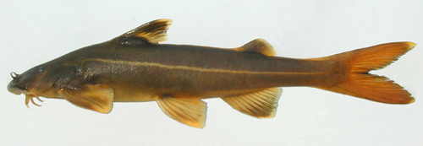
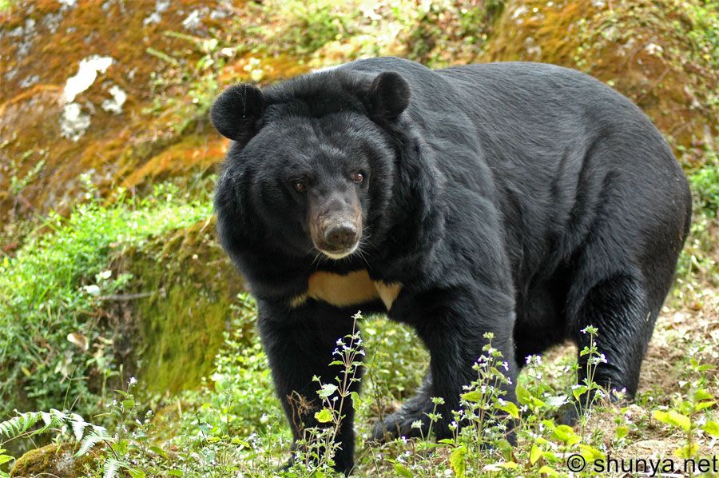

TEMPERATE ZONE
over 800 different species of birds, rare fish, endangered mammals

Slide 29
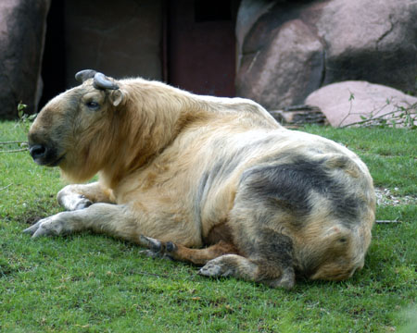

TEMPERATE ZONE
Eastern Himalayan temperate zone is home to many species of rare mammals: red pandas, takins, musk deer.
Reside in largely uninhabited dense forests
RIGHT: RED PANDA
LEFT: TAKIN

Slide 30
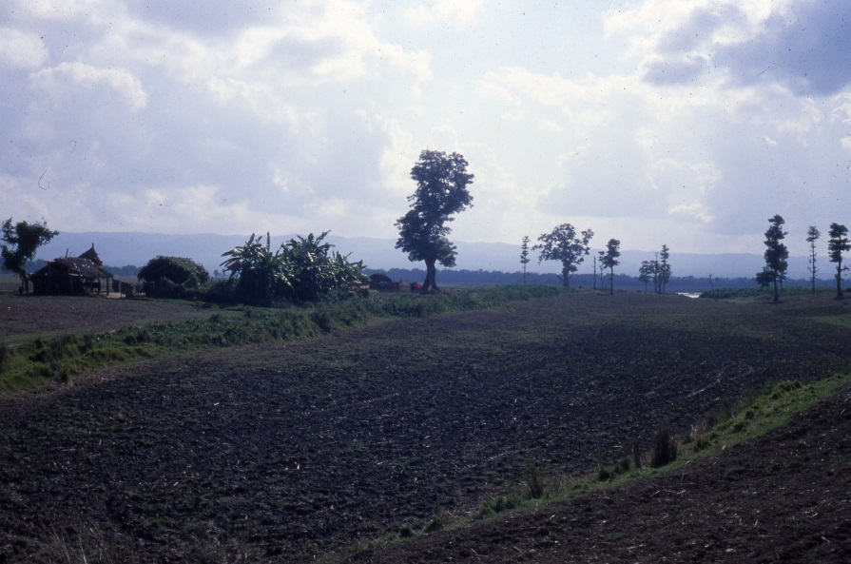
TROPICAL & SUBTROPICAL
Moist climate allowed deciduous forests to cover most of Submontane Himalaya
Few unlogged stands exist
Until recently, malaria limited settlement and movement
Regional trend: heavy logging makes way for agriculture

Slide 31
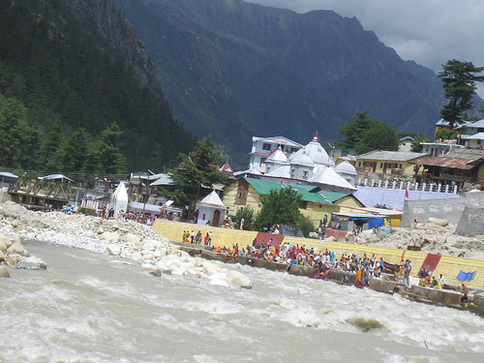
TROPICAL & SUBTROPICAL ZONE
Former home of tigers, leopards, rhinoceroses, and deer: these species now restricted largely to sanctuaries in India & Nepal
Himalayan foothills, one of the most densely populated areas in India.
Due mainly to the exceptionally fertile land.

Slide 32
HUMAN ADAPTATION TO REGION
Farming of crops suited for climate zone (buckwheat and barley for alpine zones;
rice and corn for lower zones)
Domesticated animals according to altitude tolerance (yaks in highest settlements;
yak-cow cross-breads in temperate; water buffalo/cows in tropical zones
Human preference for: fertile soils; watersheds for irrigation; trade routes

Slide 33


Slide 34




Flora

Slide 35







Fauna

Slide 36



Slide 37


LEGEND OF THE YETI
Sidebar:
Tales of the ‘MEH-TEH’, (“Man-bear”) exist among various Himalayan peoples
Despite several expeditions and decades of searching, no scientifically-reliable evidence of this creature has been produced
Hoaxes frequent
Scene from TinTin in Tibet

Slide 38



Slide 39


Slide 40




Slide 41


Slide 42


Slide 43


Slide 44


Slide 45


Slide 46


Slide 47


Slide 48


Slide 49


Slide 50


Slide 51


Slide 52


Slide 53


Slide 54

Later, Tibetanization transforms mid-hills with Tibeto-Burman speaking migrants and who practice Buddhism

Slide 55


Slide 56


Slide 57


Slide 58


Slide 59


Slide 60


Slide 61

Indic Culture Migrates North

Slide 62


Slide 63
Highlands
Over the last 3000 years, Indian peoples migrated to the north, first to places that would support:
Intensive rice cultivation
Cow pastoralism
Establishment of caste society and brahman priests
Plains

Slide 64


Slide 65


Slide 66


Slide 67


Slide 68


Slide 69


Slide 70


Slide 71


Slide 72


Slide 73


Slide 74




Slide 75


Slide 76





Slide 77




Slide 78



Slide 79

Kathmandu Valley

Slide 80


Slide 81


Slide 82

Art

Slide 83

Texts

Slide 84

Architecture

Slide 85


Slide 86


Slide 87


Cultural Performances

Slide 88


Hindu-Buddhist Survival

Slide 90

Six Ethnographic Regions in the Himalayas

Slide 91


Slide 92

Submontane Ethnic Groups: Hindu and Tribal

Slide 93


Slide 94


Slide 95


Slide 96


Slide 97


Slide 98

Mid-hills: Pluralistic of Tibetanized and Indicized Groups

Slide 99


Slide 100


Slide 101


Slide 102


Slide 103


Slide 104


Slide 105


Slide 106


Slide 107


Slide 108
Trade and Religious Pilgrimages link these regions

Slide 109


Slide 110

Trade and the “Friction of Distance”

Slide 111


Slide 112


Slide 113


Slide 114


Slide 115




Slide 116


Slide 117



Slide 118




Slide 119
Summary
Frontier Periphery Indo-Tibetan/Sino Interactions
...Micro climate/cultural features
Cultural Oases [preserving archaic cultural elements, sometimes innovating on them...]
Rare and Intermittent incursions/influences by outsiders but transformative
adding to the rich historical dialectic

Slide 120


Slide 121



